Slide 1

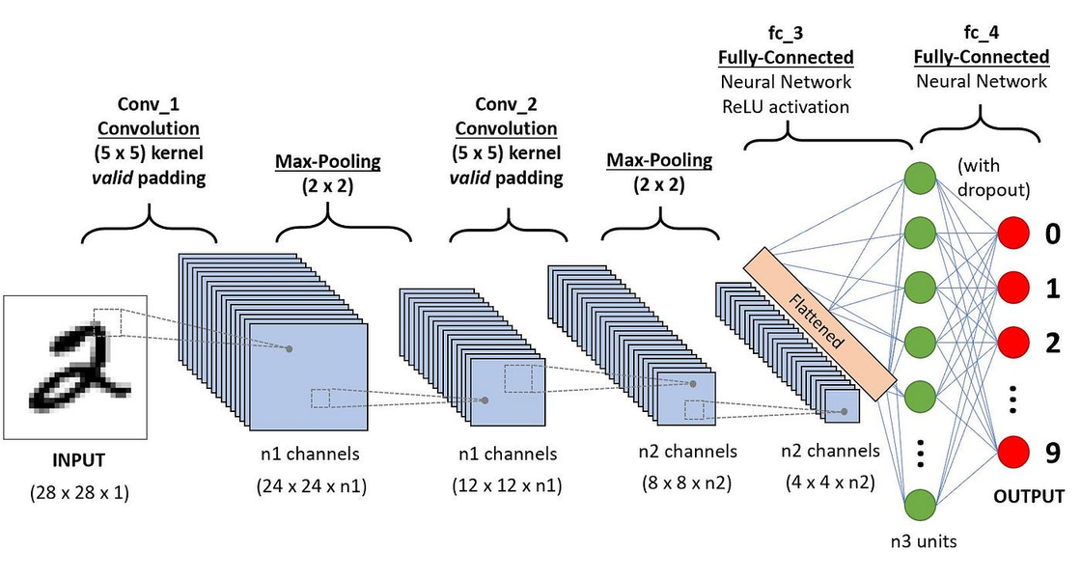

Image Classification
By: Glenn Hakim

Slide 2


Overview
Introduction Case
01
Dataset Usage
02
Features and Labels
03
CNN
04
Optimization
05
Activation functions
06
Layers and Weight
07

Slide 3
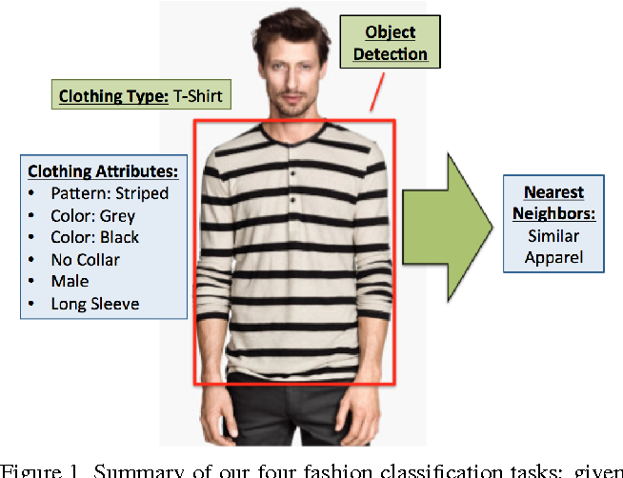
Introduction Case
Revolutionizing Fashion with AI
In the world of fashion, recognizing patterns and understanding designs are key to innovation. This project leverages a Convolutional Neural Network (CNN) to classify fashion items from the widely used Fashion MNIST dataset. By simulating how the human brain processes visual information, this model aims to efficiently categorize items into predefined classes.
Documentation: Keras Dataset Fashion-MNIST

Slide 4

Dataset Usage
Fashion MNIST: A Modern Benchmark
Purpose: To replace the outdated MNIST digits dataset with a more challenging and real-world alternative.
Description 01
Description 02
Description 03
Contains 60,000 training images and 10,000 test images.
10 categories of clothing, from T-shirts to sneakers.
Grayscale images, 28x28 pixels, representing low-complexity yet diverse visual data.

Slide 5



Feature and Labels
Understanding the Data
Features
Labels
Key Insight
Each image is a 28x28 grayscale matrix, normalized to a range of 0–1.
Flattened, this results in 784 features per sample.
Encoded as integers (0–9), corresponding to classes like T-shirt/top, Trouser, Pullover, Dress, Coat,
Sandal, Shirt, Sneaker, Bag, Ankle boot.
784 features are processed by CNNs to extract spatial hierarchies, converting raw pixels into meaningful patterns.

Slide 6
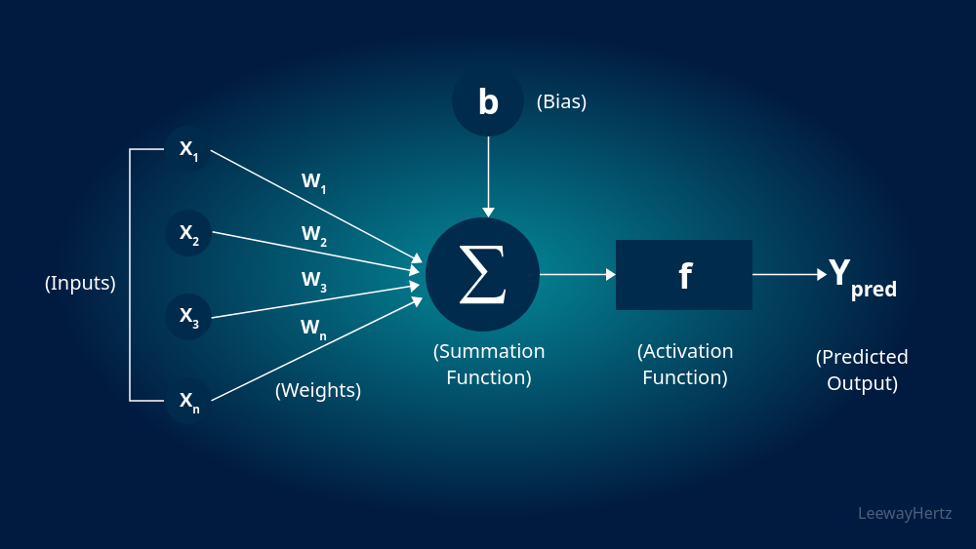
Convolutional Neural Network
Mimics the human visual cortex.
How CNNs See the World
Strength: Automatically learns spatial hierarchies without manual feature engineering.
Utilizes convolution layers to detect edges, textures, and shapes.
Key stages:
Convolution: Feature extraction.
Pooling: Dimensionality reduction while preserving key information.
Fully Connected Layers: Decision-making based on extracted features.

Slide 7
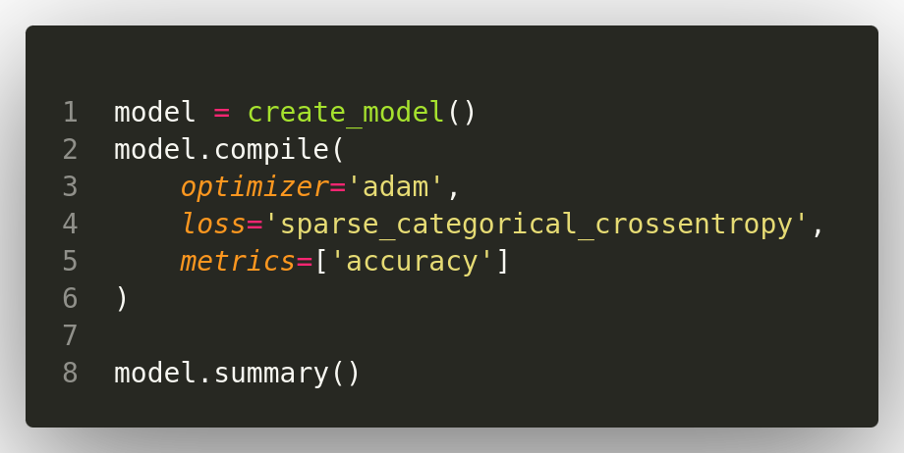
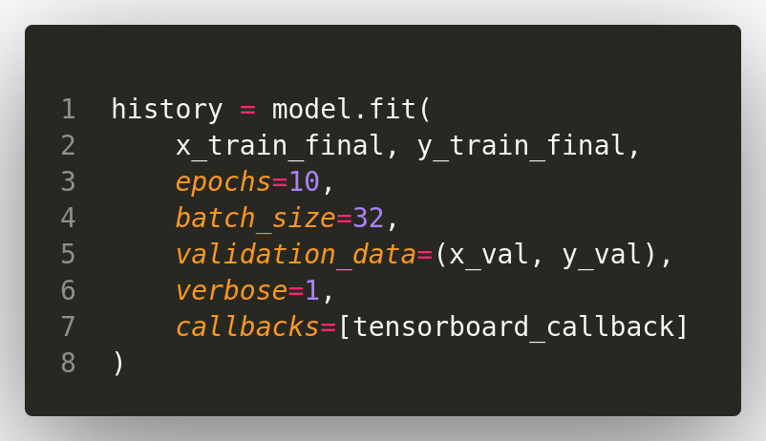
Optimization
Fine-Tuning the Learning Process
Optimizer: Adam (Adaptive Moment Estimation) for fast and efficient learning.
Loss Function: Sparse Categorical Crossentropy to handle integer labels effectively.
Metric: Accuracy as a straightforward performance measure.
Hyperparameters:
Batch size: 32.
Epochs: 10.

Slide 8
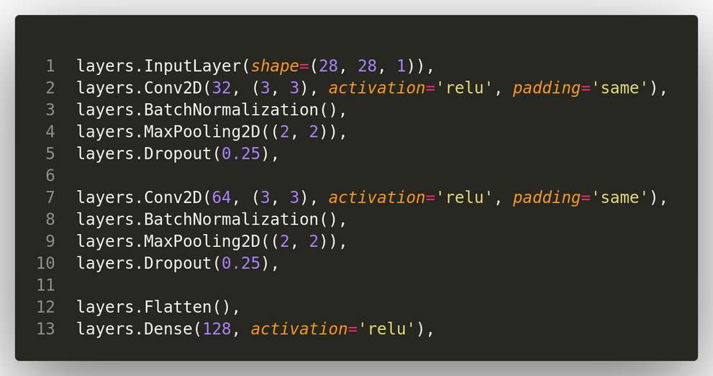
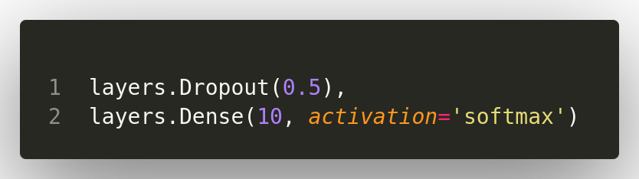
Activation Functions
Activating Neurons in the Network
ReLU (Rectified Linear Unit):
Ensures non-linearity, enabling the network to learn complex patterns.
Formula: f(x)=max⁡(0,x).
Softmax:
Converts logits into probabilities for multi-class classification.
Ensures output values sum up to 1.

Slide 9
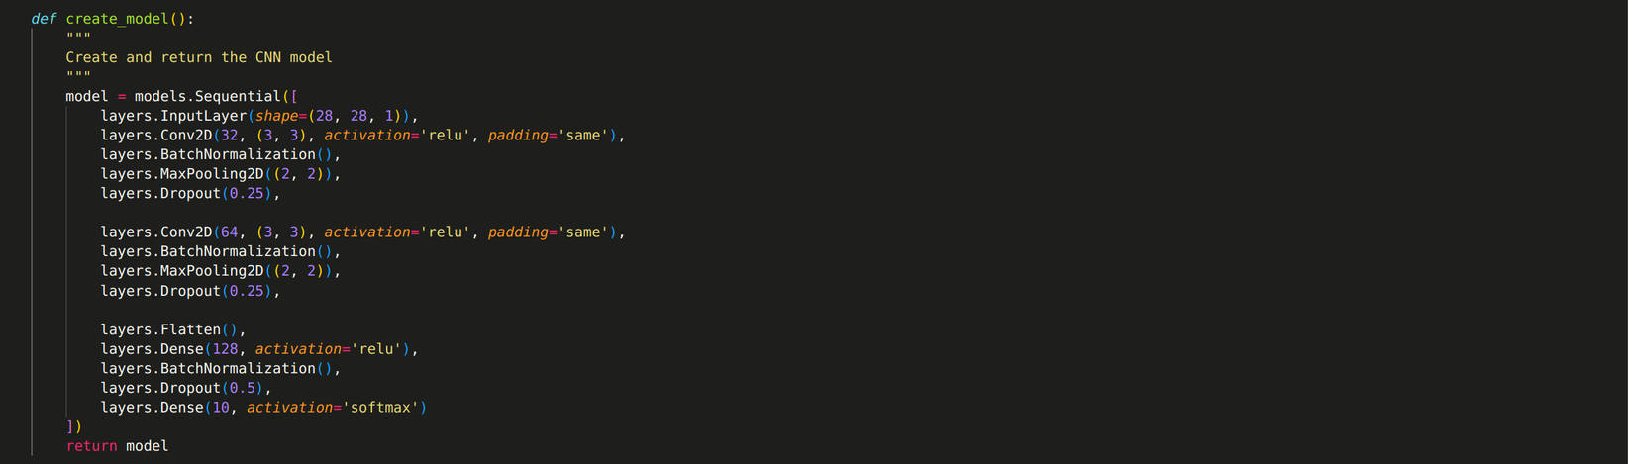
Layers and Weights - 1
Building Blocks of the Model
Convolutional Layers:
Pooling Layers:
Dense Layers:
Dropout Layers
Filters (kernels): Learn spatial patterns.
Example: 32 filters of size 3×3 the first layer.
MaxPooling reduces dimensionality while preserving important features.
Fully connected, used for high-level reasoning.
Last layer has 10 neurons, representing the 10 classes.
Prevent overfitting by randomly disabling neurons during training.

Slide 10
Layers and Weights - 2
Building Blocks of the Model
Hidden Nodes
Weights
Hidden nodes are units in the layers that process and transfer information through the network. Here's the node breakdown for each layer:
Layers Hidden Nodes
Conv2D Layer 1 -> 25,088
MaxPooling2D Layer 1 -> 6,272
Conv2D Layer 2 -> 12,544
MaxPooling2D Layer 2 -> 3,136
Flatten Layer -> 3,136
Dense Layer 1 -> 128
Dense Layer 2 -> 10
Weights are trainable parameters representing the strength of connections between layers. These weights are adjusted during training to minimize loss.
Layers Weights
Conv2D Layer 1 -> 320
Conv2D Layer 2 -> 18,496
Dense Layer 1 -> 401,536
Dense Layer 2 -> 1,290
Total 50,314 Hidden Nodes
Total 421,642 Weights

Slide 11


THANK YOU

